Slide 1
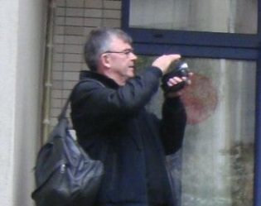
Introduction to the inductive method and inclusive epistemology
The scales of observation method
Dominique Desjeux, anthropologist
Professor Emeritus, Sorbonne humanities, University of Paris
D. Desjeux, 2004, Le sciences sociales, PUF, Que sais-je? (Social Sciences)
D. Desjeux, 2006, La consommation, PUF, Que sais-je? (Consumption)
S. Alami, D. Desjeux, I. Garabuau-Moussaoui, 2008, Les méthodes qualitatives, PUF, Que sais-je? (Qualitative methods)
D. Desjeux, 2018, The anthropological perspective of the world. The inductive method illustrated, Peter Lang
University of Padova, 2021 May 3,4 and 12
Moderate by Professor Francesca Setiffi

Slide 2

Day 1
What is an inductive method
Does it mean the researcher has nothing in the mind?

Slide 3
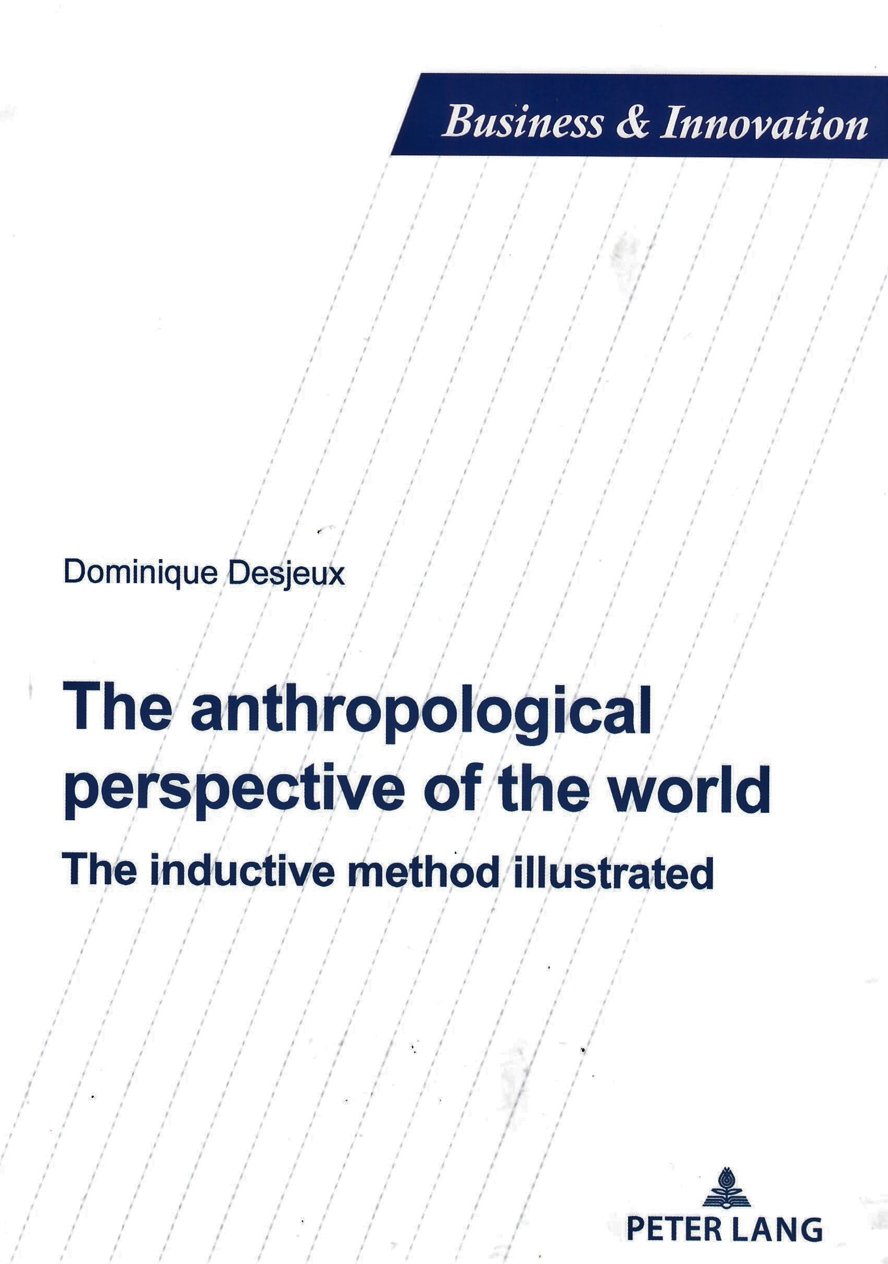
How to make a link between abstract concepts and concrete qualitative data
What is the relationship between the world of field studies and that of theory?
How to move from a “mere” description to an interpretation – what is the meaning of the word “theory”?
The solution I propose here is based on my own experience in carrying out socio-anthropological qualitative field studies since 1969. It represents one possibility, among others.
Cf my last book, published in 2018, The anthropological perspective of the world. The inductive method illustrated.

Slide 4
One solution consists in looking at reality as an enigma to be solved.
Most of my field studies are requested and financed by social actors, mainly private companies, public organizations, or NGOs.
Hence, each time, I am asked to solve a problem such as:
  • How to develop a market in China
  • Why a new technology has succeeded or not
  • How to change the organization of a big company
  • Why families are not following the prescriptions of the doctor
  • How homeless people deal with daily life
  • What the link is between disabled persons and consumption
  • How to improve the digitalization of professional practices in a high school.
•Eventually, the enigma is how to make a link between description and concept.

Slide 5
Solving a concrete enigma helps to create “descriptive concepts”
A descriptive concept fits with reality.
  For instance, if I work on the political organisation of a society, I can start with the concept of the State, which is a very abstract word and so very often an ideological word full of value judgments for or against it.
  I can shift from the abstract concept of State to that of “bureaucracy”, as Max Weber did. It is more concrete. M. Weber describes the main features of a bureaucratic system, such as “impersonal rules”; “promotion by seniority”; there are no concrete social actors.
  I can then shift to a more concrete concept of organisation of a public administration or department to describe the “social interplay of the civil servants” based on power relationships and social networks.
The functioning of an organisation is the “descriptive concept” of the State.
How it functions is the enigma to be solved, and so a great number of descriptions are needed.
My main concepts derive from observing the constraints that shape the behavior of social actors.

Slide 6
Introduction to the inductive method

Slide 7
What is an inductive method?
It means launching a qualitative field study without knowing where to go and how social actors deal with the problem we are asked to clarify.
We are like a Western navigator of the 16th century discovering a new world.
He only has three tools:
  a compass to know where the north is
  a sextant to calculate his position
  a lead line to measure the depth of the water and so avoid rocks.
And one methodological hypothesis that is the rotundity of the earth… but without any certainty when going west

Slide 8
My four main tools of navigation to describe a social reality as a system
The scales of observation (“lens”, scope, and “decoupage”)
  Reality changes when changing scale
  The causality is not the same depending on the scale
The itinerary method
  The decision is seen as a collective process
Qualitative life cycles
  Describing the construction of social identity
The open system of action
  Discovering the social actors who are involved in the process of innovation, using a consumer product, a service, or decision-making.
These are the mental frameworks I have in my mind when discovering a new reality.
But I have no hypothesis about any link between one phenomenon and another.
I only know
  It is impossible to observe a social reality all at once (d’un seul coup). I must make slices of (“découper”) reality. There is no holistic field study.
  It is important to make a distinction between practices and representations.

Slide 9
Five principles to carry out precise qualitative field studies
1 - Induction, as a means of exploring reality without making any hypothesis other than methodological hypotheses.
With the inductive method we presuppose that there are material, social and symbolic constraints which organise the behaviour of actors (and the gaps between representations and practices), as well as the effects of lifecycles or gender-based division of tasks.
Finally, the decisions made are seen as resulting from a process over time (and not a single moment), and as the result of social interactions, at least at our microsocial and mesosocial scales of observation.
2 - Ambivalence, which postulates that all reality contains a negative side and a positive side, and that these are indissociable.

Slide 10
About the généralisation of a qualitative field study (principle 3)
3 - The generalisation of the diversity of usages as a function of their occurrence (which generally varies between 2 and 5), avoiding any interpretation in terms of frequency, which would not make any sense for such a small sample.
A practice observed once is as valuable as a practice observed 10 times, and sometimes even more if it is the sign of a weak signal that is currently emerging.
It is also possible to generalise social mechanisms or cultural models, but without concluding anything in terms of frequency, which would be the task of a quantitative investigation.

Slide 11
These five principles form the basis of the reliability of qualitative investigations.
4 - A comprehensive approach, without value judgments or accusations.
  We take the point of view of the actors as a point of departure to understand their practices and the sense which they give them,
  to display the underlying social mechanisms which are beyond the actors’ mere perceptions or experiences.
5 - A principle of symmetry with respect to the effectiveness or ineffectiveness of an action. An action which is ineffective is as interesting to observe as one which is effective
We postulate that a quantitative frequency is not truer than the diversity of occurrences, but that it teaches us something else.

Slide 12
Day 2
Discovering the gap between concept and reality

Slide 13
How I was confronted, as a young researcher, with the gap between abstract concepts and concrete data
In 1975, I was sent to Congo for 4 years to a college of Agriculture at the University of Brazzaville, to teach anthropological methodology applied to rural development projects.
Before going to Congo, I read many theoretical books about the small farmer's rules of kinship and the economic system of production.
The main theoretical concept was the one of “lineage mode of production”, which is a very abstract term.
It mainly refers to how old men dominate young men and women in the context of rural villages.

Slide 14
When I started my field study within the village of Sakameso,
I was searching for this mode of production
I had to describe the process by which men and women cultivated cassava, a root that needs one year to ripen, and which could be picked for two years every two weeks.
Cassava is like a “natural granary”, unlike wheat, which needs a “built granary”.
That is why most often there is no central State involvement when small farmers cultivate roots, unlike cereal, which needs irrigation systems and systems of granary stock, and so State involvement.
Cf. James C. Scott, 2017, Against The Grain. A Deep History of the Earlier States, Yale University Press (-3500 BC)

Slide 15
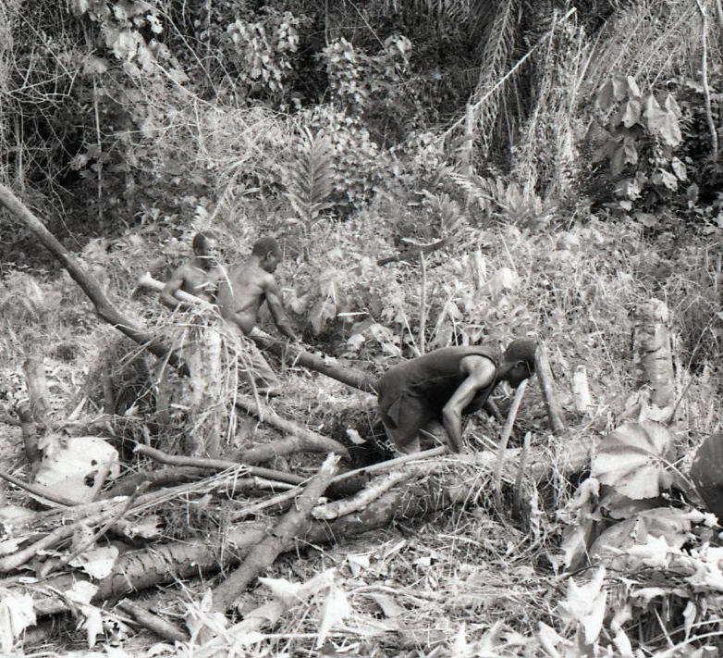
I did not see any lineage mode of production
I observed men cutting wood to prepare the cultivation of cassava, which is a typical gender division of labour
1975-1979, photos D. Desjeux

Slide 16
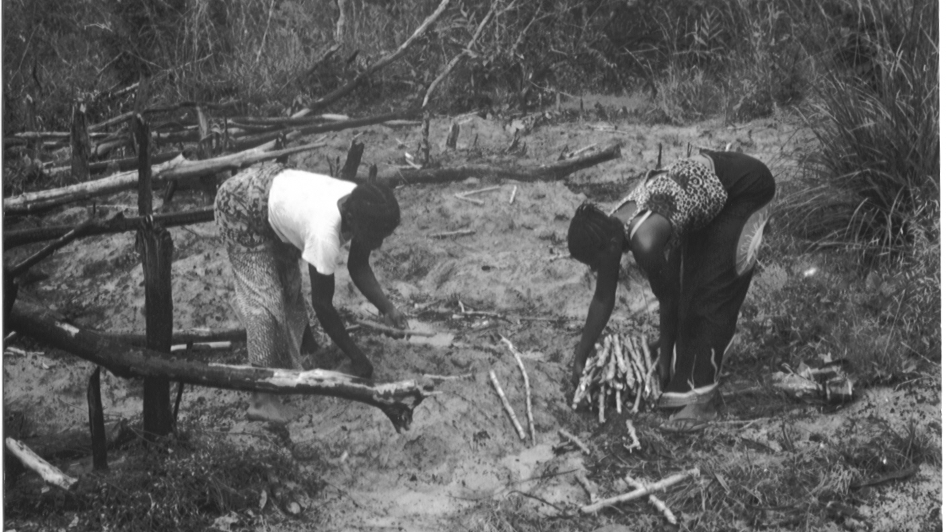
Women planting cassava
1975-1979, photos D. Desjeux

Slide 17
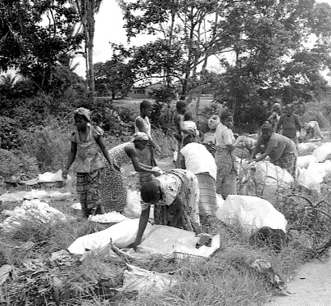
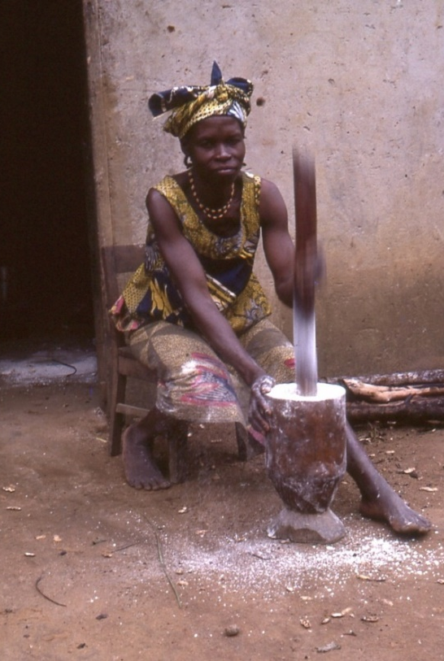
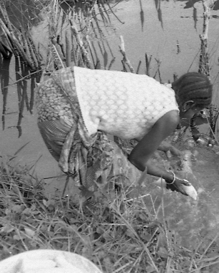
Processing of cassava by women
Removing the hydrocyanic acid
Selling the cassava
Transforming the manioc into cassava flour for cooking
1975-1979, photos D. Desjeux

Slide 18
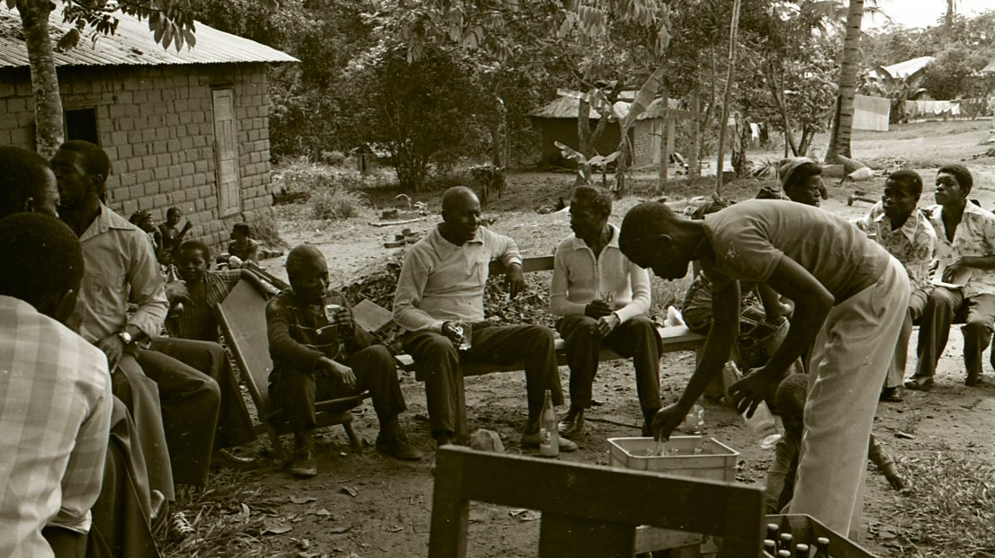
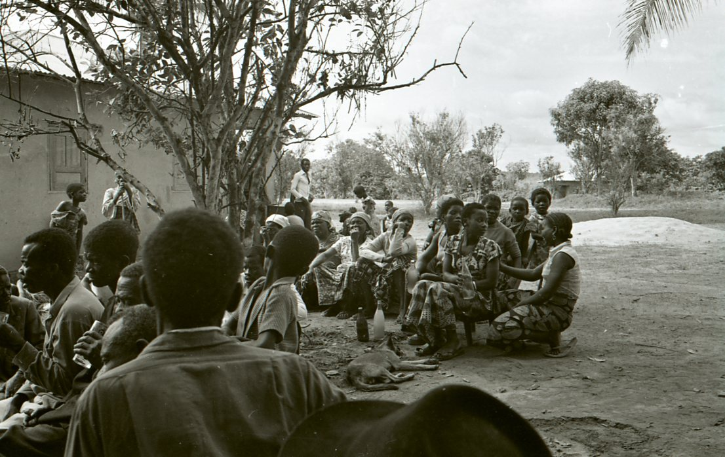
Wedding ritual with a gender division of the village public space
men
women
1975-1979, photos D. Desjeux

Slide 19
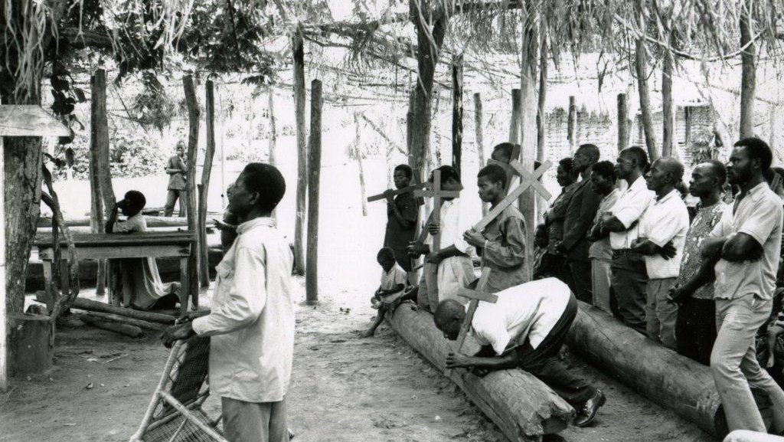
Cults against bewitchment
1975-1979, photos D. Desjeux

Slide 20
Day 3
Some slides to help discussing the scales of observation method

Slide 21
I finally discovered the three main levels of social life, based on three “descriptive concepts” linked to three kinds of constraints
Material culture based on the agricultural itinerary of cassava
Social relationships between men and women, old and young people and among members of families: power relationships, cooperation and building of identity.
The imagination or symbolic level with “witchcraft” and “sorcery” (which are difficult to distinguish).
Witchcraft is a way to explain the difficult times of daily life and so to give a meaning to life.
Later I applied this dimension to deciphering advertising as an animist process
Each level is linked to a set of material, social and symbolic constraints

Slide 22
I apply these three sets of concepts to a great number of situations, such as consumption, innovation, and decision-making processes in organisations, households, or open social systems of action
This approach mainly works at the mesosocial and microsocial scales of observation

Slide 23
The level of material culture
With material culture I try to find the ways (itinerary method) by which a consumer good or a service is obtained or “built” or “created” by social actors, individuals or collective actors
My main questions are how do you do this or that, with whom, and where, to describe the concrete system of objects. I only have a few questions about “why”.
So, thanks to these constraints, I know why actors do what they do. Most often, but not always, they adapt their decision to their constraints.
When understanding the system of objects, I elucidate the invisible constraints which weigh on social practices and on the decision-making process

Slide 24
The level of social relationships, which means analysing the social interactions, the social interplay among actors
With social relationships, I try to describe who are the main actors involved in the social process depending on the stage of the itinerary
Where is the “area of uncertainty”?
What are the constraints which weigh on the social situation?
It is the level of practices, social strategies and constraints and potentiality
My main question is how?
Who is controlling this area?

Slide 25
The level of social imaginary
It is the world of representations in which opinions, values, symbolic meanings, and perception of reality are found
It is the main level by which I discover what the actors’ meanings of life are, how they build their identity (cf. life cycle method)
Most often I find that there is a gap between the world of representations and that of practices
I explain this gap by the existence of the material, social or symbolic constraints
That is why the world of representation is most often interpreted as a way to justify social action than as a “triggering event” of action.
When searching for understanding representations, my main question is why?
There are some exceptions such as “activist”, “believer” or “entrepreneur” actors, for whom the imagination is very important in helping to trigger action.

Slide 26
The 11 great material, social, and symbolic constraints which organise the diffusion of innovations: my main descriptive concepts
The 5 materials constraints
Time: Does the proposed change save time or waste time?
Space: Is there enough physical space to make the change (bathroom, bedroom, or living room at home, and sales areas outside)?
Budget: Can the change be borne financially?
The system of concrete objects is necessary for the use of a new product or service.
The 3 social constraints
Learning: Is it complicated to learn? This constraint can disappear if there is a strong survival or budget constraint.
Group norm: between what is implicitly prescribed, permitted, and forbidden within a group
“Predigital” and digital social networks as a basis for the interplay of actors who produce norms in favour of or against an innovation
The 3 symbolic and psychological constraints
Personal or professional identity: Will the change “lower or raise the face” of the other, as they say in China? Does it affect male or female identity or social status?
Perceived risks in the case of cosmetic products: are the cosmetic products perceived as being threatening for the skin or for the eyes?
Mental burden: does the change lower the mental burden or not? This is an important concept which comes from ergonomics. The change will be difficult to bring about if the new practice increases the mental burden, for instance if it is more complicated to use
The energy that allowed the system of objects to work.

Slide 27
Learning how to abstract a pattern of explanation from the description of a reality and then transposing it to another reality thanks to “descriptive concepts”
Decision-making process
Area of uncertainty
Constraints

Slide 28
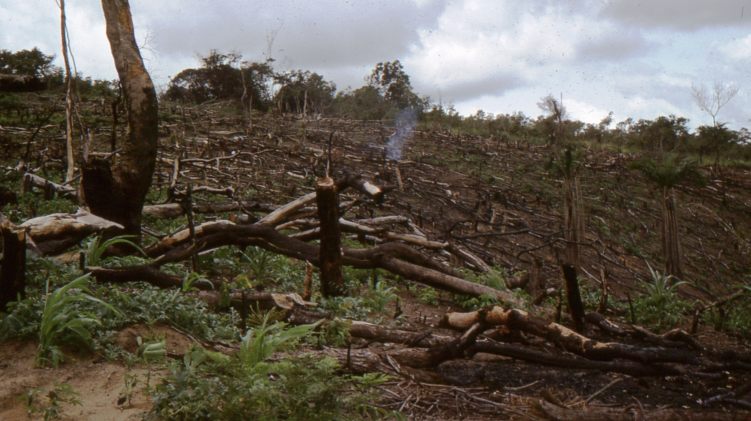
Thanks to the agricultural itinerary, I discovered how to make a link between a decision-making process and an itinerary
What I learnt when observing big organisations with French sociologist Michel Crozier in 1969-1971, is that a decision could be observed as a collective process, and not only as a individual trade-off at one moment.
Now I know that it depends on scales of observation, as I discovered in 1987 when writing about Congolese small farmers.
At the micro-individual level of observation, a decision can be analyzed as a trade-off made by an individual.
At a mesosocial and microsocial scale of observation, a decision is analysed as a social process made up of interactions among several actors under some constraints of situation
At a macrosocial scale, the decision vanishes and is replaced by correlation as an indicator of causality.

Slide 29

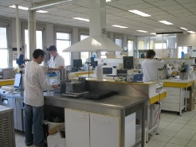

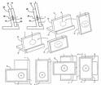







An example of itinerary following the stages of the life of a product or service: production, transformation, circulation, consumption, and disposal
R & D
C & D
(Connection)
Marketing
Advertising
Packaging
Disposal
Recycling
Social life
of things
Distribution
Purchase
Storage
Use
Opposition
Advertising Transsubstantiation
Enchantment of distribution

Slide 30
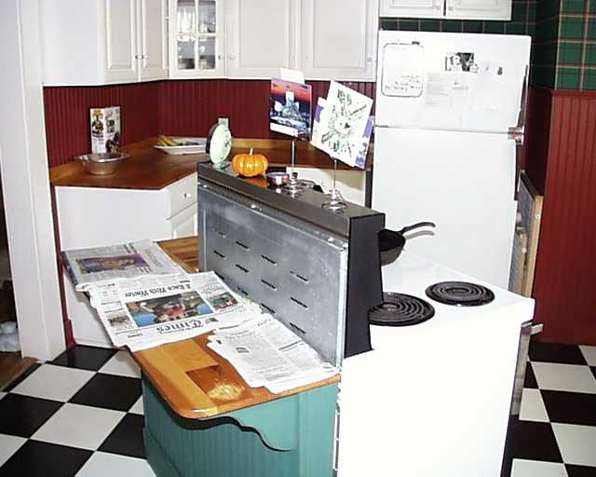

The itinerary method applied to food consumption behaviour: the decision-making process
1999, kitchen, USA
Practices
Constraints
Representations
Microsocial
Itinerary
Buying
Receiving
as a gift
Stealing
Decision
Domestic
Space
Internet and
screens
Mobility
to shopping
place
Storage
Use
Disposal
Recycling
2018, computer, France

Slide 31
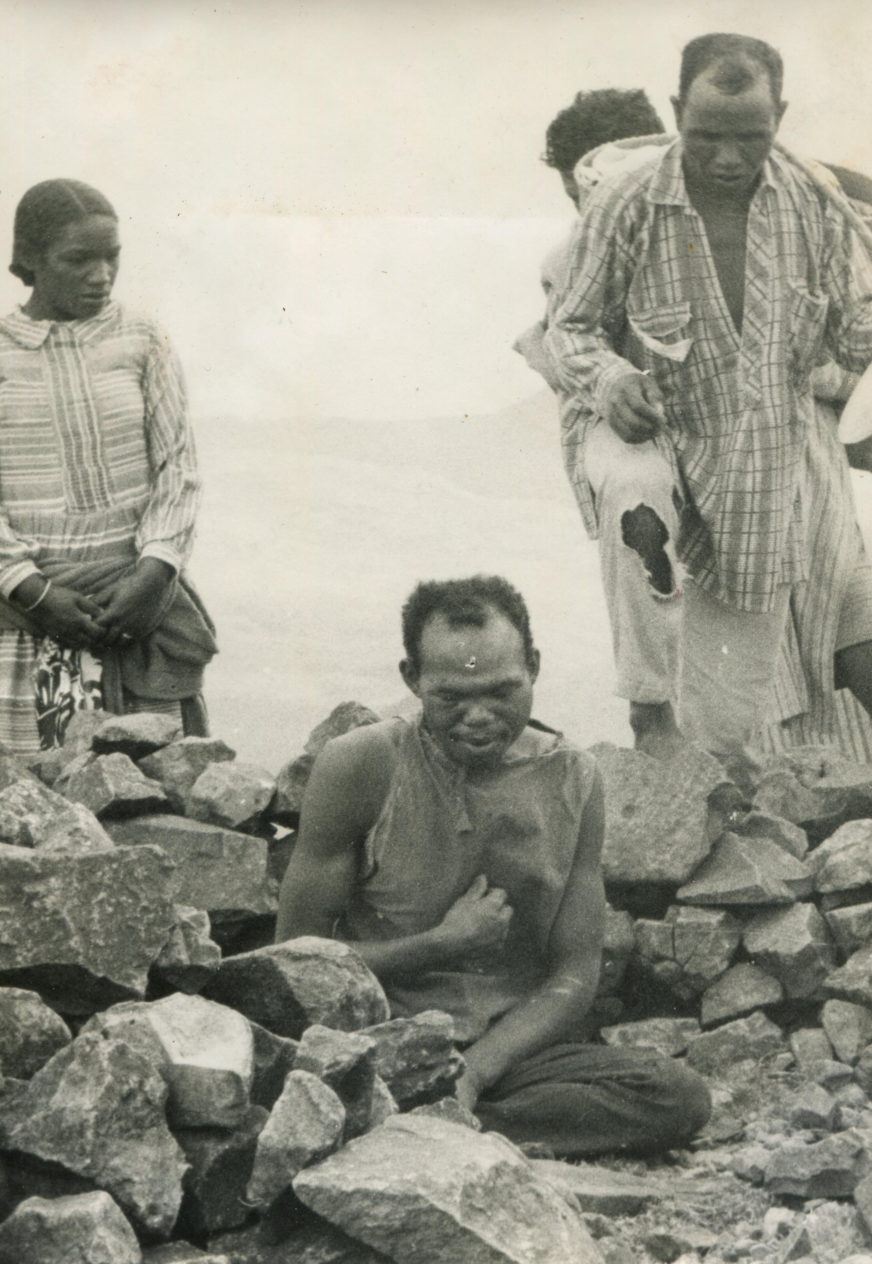
Thanks to “witchcraft,” I discovered how to abstract and then to transpose the concrete concept of an “area of uncertainty” from the world of big organisations to that of small farmers
1971, divination in Madagascar
When observing big organizations, I understood that the question of power is not limited to the one of domination, which “squashes” the social interplay of actors, nor the one of authority, which only focuses on an individual feature, even if domination and authority do indeed exist.
At a mesosocial and microsocial scale of observation, power is seen as a relation among actors that are organised around an area of uncertainty.
In big organizations, a typical area of uncertainty is machine failure. The time when this occurs is unforeseeable.
Most of the actors, therefore, depend on those actors who can repair or change a piece of machinery.
A video on divination, by Dominique Desjeux
https://youtu.be/aVCzaanUueE
Photo D. Desjeux

Slide 32
The area of uncertainty is a source of power, and so, in this situation, power is not an asset but a relation
The area of uncertainty is most often controlled by the maintenance workers, who can go fast or slowly to repair the machine and so have the choice whether to disadvantage the other workers
That means that if that area changes, the power relationships will shift from one kind of social actor to another.
It is frequent in the process of digitalisation in which most of the organization are involved. It is a new form of expertise, and so it brings new uncertainty and therefore new actors controlling this area of uncertainty.

Slide 33
The transposition of the area of uncertainty from maintenance to witchcraft
To make a long story short, in the Congolese village, there are many areas of uncertainty, such as the climate for agriculture when there is too much rain, for example.
The other area of uncertainty is the moment when one will die. It is believed that there is no natural death.
It means that the death is seen as being provoked by the chief of the family, the head of the lineage (the brother of the mother in a matrilineal system of kinship, as in South Congo)
The head is supposed to have the power to protect the members of the family or to cast a spell on any member.
Hence, when a member of the family is sick or dies, he or she is thought to have been killed by the head of the family.
His power is based on the control of this area of uncertainty. He can threaten the members of the family who disobey, for example.
That means his power is based on a symbolic belief.
In fact, it is necessary to “turn around” the explanation to understand that this explanation is mainly a way to give a meaning to the pains of daily life, but this explanation/belief is also a power device in the hands of the family heads.

Slide 34
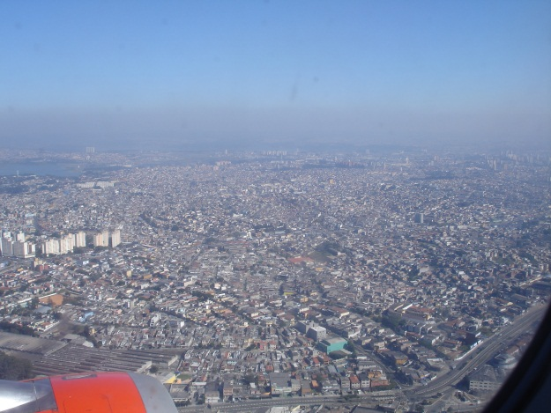
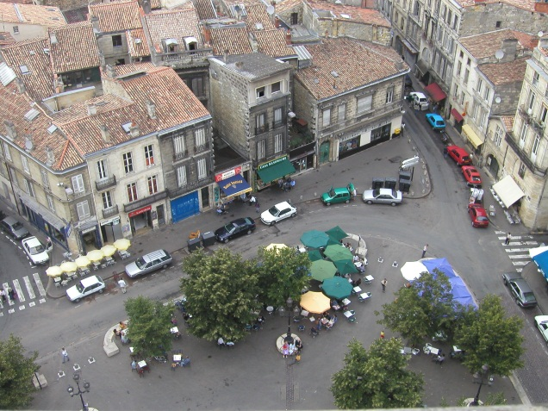
Scales of Observation Applied to Consumption
Macrosocial scale: Individual actor is invisible
  General view of social classes, genders, generations and cultures
  Regularity and average figures
  Consumption as a lifestyle
Mesosocial scale
  Organisation and social system of action
  Consumption as a power relationship among actors
Brazil, Sao Paolo, 2006
France, Bordeaux, 2005
Photos D. Desjeux

Slide 35
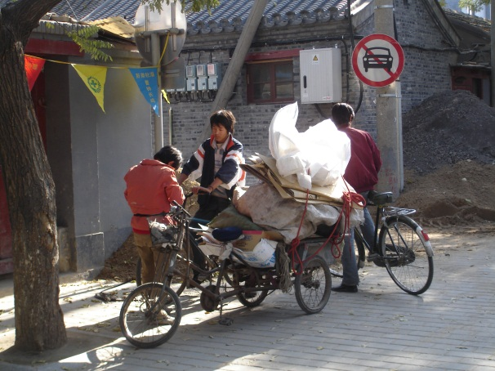
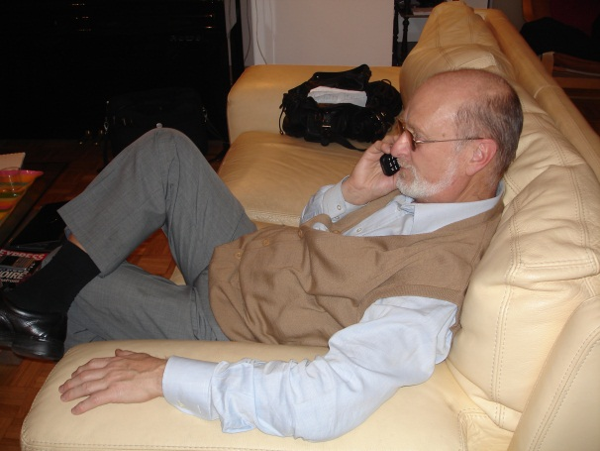
What is seen on one scale disappears at another scale of observation
Microsocial scale
  Interactions among actors
  Consumption as an itinerary
Micro-individual scale
  An individual is mainly visible at a micro-scale
  An individual is unique
  Consumption as a trade-off
Beijing 2007
Paris 2007
Photos D. Desjeux

Slide 36
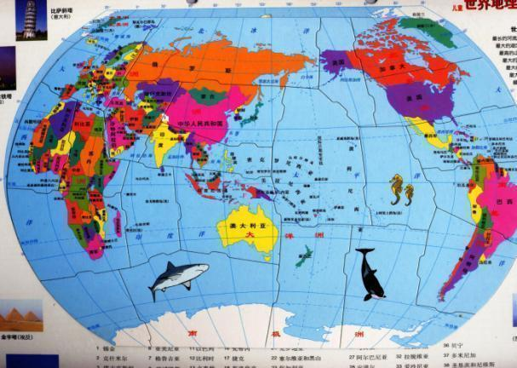
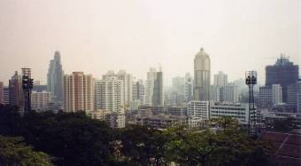
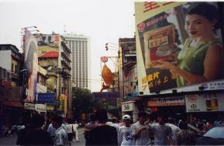
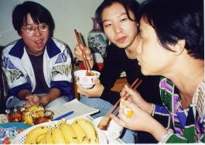

Scales of observation, correlation as indicator of causality, situation effect, meaning
Geopolitics
Macro-social scale
Correlations, regularities
Way of life, life style
Social belonging
Depending on the scale, one phenomenon which
could be visible at one scale, but becomes invisible
to another scale of observation
Meso-social scale
Organizations,
Groups of pressure
District, system of action
Itinerary of practices
Situation effect
Meaning, interest
Power relationships
Social interactions in daily life
Consumer spending as a decision-making process, Family
Micro-social scale
meaning, correlation
Cognition, motivation, the unconscious
Micro-individual scale
Biological scale
Cell
Observation is discontinued
2019, Dominique Desjeux

Slide 37
The observation of reality is discontinuous and so there is no overall theory
If there is no overall view of social reality, that means that there is no overall theory.
Each limited generalisation is valid at one scale of observation and within the nearby scales.
And so, there is only “limited generalisation”.
That is why each theory has a share of validity alongside other theories.
And so, on the one hand, this is an inclusive epistemology that accepts what is true in each approach.
But on the other hand, it is not a merging theory, because there is no overall theory that integrates all the other explanations of reality.
Ultimately, a theory is not valid when it attempts to provide an overall explanation for the whole of reality.
When a theory is too coherent, it is a sign that it is not a relevant theory, because a paranoiac is very coherent…

Slide 38
One main conclusion is that when the scale of observation is changed, not only the content of the reality changes but also the causality
For example, domination is a concept which works at a macro-scale of observation the causality of which could be based on correlation as an indicator of a statistic causality
But at the mesosocial and microsocial scales of observation, the causality depends on constraints, that is, on the “effect of situation”, which is an unstable system of action.
The instability of the situation and the variability of constraints explain why social actors have some margin for manoeuvre and so are not dominated, i.e., they are not passive
cf. Asylum, in which Erwin Goffman shows the margin for manoeuvre of “insane” people
At a micro-individual scale of observation meaning could be seen as a causality to explain why a subject does an action, without eliminating other factors of causality such as constraints, cognitive perception or the unconscious.

Slide 39
Freedom and scale of observation
Scale
Observation
Macrosocial
Mesosocial
Microsocial
“Determinism”, correlations
Room for manoeuvre
Effect of situation
Micro-individual
Maximum freedom
“Determinism”
Biological

Slide 40
What is the solution of the enigma?
First phase: discovering truth
The first objective of a qualitative field study is to discover what “a truth” is, but not what The Truth is.
So, one important moment, when you gather information, is the way you ask people what their practices and meanings are.
The quality of your information ensures the truthfulness of your field study.
Truth is then discovered in describing the reality you draw from observation and discussions with “subjects”.

Slide 41
Seconde phase: from subjective information to objectivisation of qualitative or quantitative data
Whether a study is qualitative based on interviews or quantitative based on questionnaires, you always get information from an individual.
This “subjective phase” allows us to transform a “concrete subject” into the “descriptive concept” of a “social actor” or concrete daily life into a “system of action”.
A descriptive process means that you can show the link between a reality and a concept. This is induction, as demonstrated by Bronislaw Malinowski in Argonauts of the Western Pacific (1922)
This “objectivisation” is based on a process of “abstraction” and is a cognitive mechanism which is included within the description when describing social reality as a set of systems, a social structure, a process of identity building, a meaning of life or a correlation.
“Objectivisation” means that objectivity is impossible in anthropological study because there are many links between the observer and the observed, and therefore, a degree of emotion and empathy.

Slide 42
Third phase: abstraction and transposition
The content of the abstraction is the fruit of very pragmatic issues, i.e., practice under the practical constraint of the “découpage” (cutting out, slicing) of reality.
Abstraction depends both on the scale of observation and on the theoretical framework that allows you to transform concrete information into qualitative or quantitative data.
  “Social actor” is one of the socio-anthropological concrete concepts of the word “individual”.
Thanks to the first transformation/abstraction of an individual into a social actor, it is possible to read the social reality as a system of action, as a system of concrete interactions based on power relationships organised around an “area of uncertainty” all along an itinerary process of decision-making working under material, social, and imagination constraints.
And so, it is possible to transpose these “descriptive concepts” of social actors, system of action, and so on from one field to the world of organisations, to the world of small farmers in Congo, and then to that of families and consumption in the modern world in France, the US, China, Brazil, Denmark, and so on…

Slide 43
Where does a concept come from?
Most often, concepts are so abstract that it is impossible to understand how to link them with our research.
That is the problem that I had with the abstract concept of a “lineage mode of production”.
I needed to understand the whole chain of concrete concepts between the daily life of the village, the descriptive concept of the system of social actors, and the abstract concept of the lineage mode of production.
This concept does not refer to the situation, but rather to the uncertain “interplay” of the social actors. It refers to the concept of domination as a principal explanation in which there is no interplay. This concept comes from the macroscale of observation, and so it does not fit with my observation, even if it is an interesting concept.

Slide 44
Opening
One main point is the constraints of “découpage” (taking slices or an analytical cut in reality), which leads to the disruptive conclusion that there is no overall theory but only “limited generalisations”.
There are only theories fitting with the scale of observation on the basis of which the data have been gathered.
It is, of course, possible to utilise some patterns of interpretation from other scales of observation to clarify our data, but not in a chain of causality because the process of information is discontinuous.
It is an inclusive epistemology but not a merging method. Each theory has its own relevance, which depends on its scale of observation.
And so, one solution to our enigma is to search at what scale of observation each concept has been produced to find how it fits with our description.

